Slide 1
CG2271 Real Time Operating Systems
Real Time Operating Systems

Slide 2



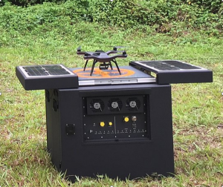
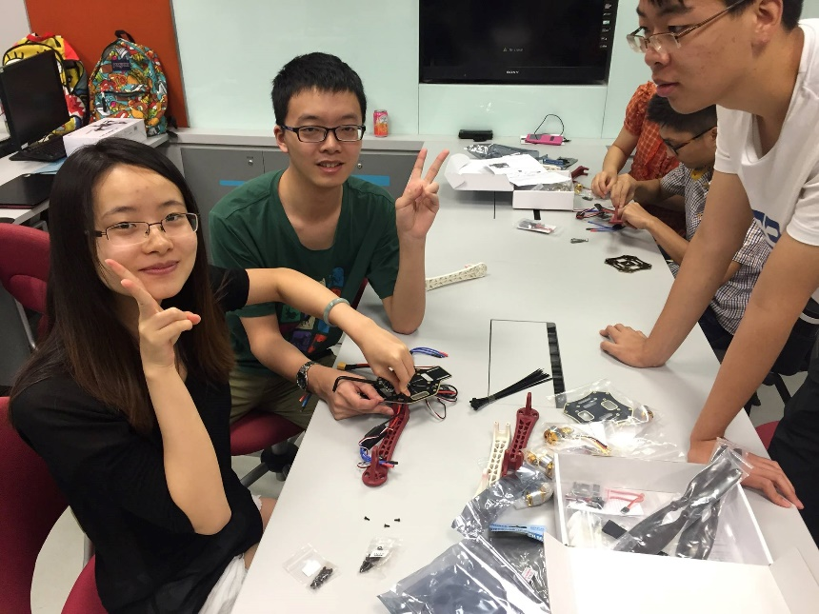

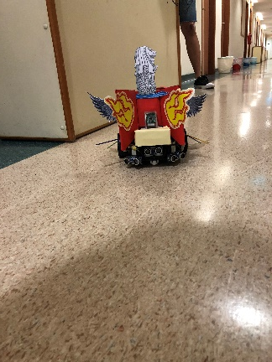
People
Colin Tan
Consultation:
Mondays 9 am to 11 am
COM2-02-08
Email: colintan@nus.edu.sg
Admin appointments:
Chief Randomness Generator,
Makers@SoC

Slide 3
Course Objectives
Synopsis:
  Introduces basic concepts in real time operating systems
  Focuses on these areas:
    OS Structure and Architecture
    Process Management
    Memory Management
    File Management
    RTOS Specific Topics
    Microcontroller Programming (ARM Cortex M0+)

Slide 4
Specific Learning Outcomes
After this course, you should:
  understand how an OS manages computational resources for multiple users and applications, and the impact on application performance
  Be able to write timing critical real-time software on microcontrollers.
  be comfortable in writing multi-process/thread programs and avoid common pitfalls such as deadlocks, starvation and race conditions within a real-time operating system.
  Able to create embedded systems using RTOS.
  be able to self-learn advanced OS topics

Slide 5
Assessment Weightage
Weightage for various components:
  Tutorial Attendance: 5%
  Lab Assignments: 10%
  RTOS Project: 15%
  Midterm: 20%
    Friday 10 October 2025, 2 pm to 3 pm (Lecture time)
  Exam: 50%
    Monday 1 December 2025, 1 pm to 3 pm.

Slide 6
Assessment – Lab Assignments (10%)
Graded Lab Assignments:
  Every lab starts with a pre-recorded lecture (you can view these lectures ahead of time if you wish), about 45 minutes.
  The lab assignments can usually be done within under an hour.
Reasons:
  Knowing ARM Programming is important for your employability.
  HOWEVER:
    Knowing OS concepts is even more important; hence we don’t want to cover ARM programming during the lectures.
    Pre-recorded lab lectures are important to complete lab assignments and the project.
    Contents of lab lectures and exercises are only used for the RTOS project and are NOT EXAMINABLE.

Slide 7
Assessment - Plagiarism
In NUS, we take a serious stand on plagiarism cases
  All lab assignments will be sent for plagiarism checks
Plagiarism for lab assignment submission:
  Once detected:
    Both supplier and consumer receive zero for that lab/tutorial
  Repeat offender:
    Zero for that particular CA component
    Report to higher authority

Slide 8
References
Main supplementary text:
  Modern Operating System (5th Edition), by Andrew S. Tanenbaum, Pearson, 2023
  Operating System Concepts (10th Edition), by
  Abraham Silberschatz, Peter Baer Galvin &
  Greg Gagne, McGraw Hill, 2021
Lecture notes:
  Will attempt to make it as self-contained as possible
Labs:
  MCXC444 Data sheet (very important)

Slide 9
References
Labs:
  MCXC444 Data sheet (very important)
  FRDM-MCXC444 Circuit Diagram

